Slide 1

INDIAN AGRICULTRE ANALYSIS

Slide 2
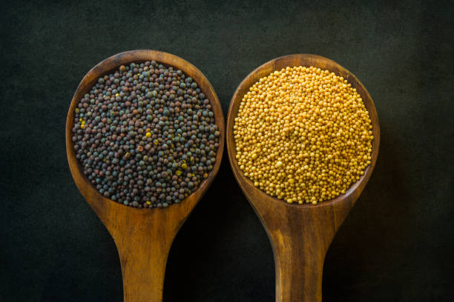
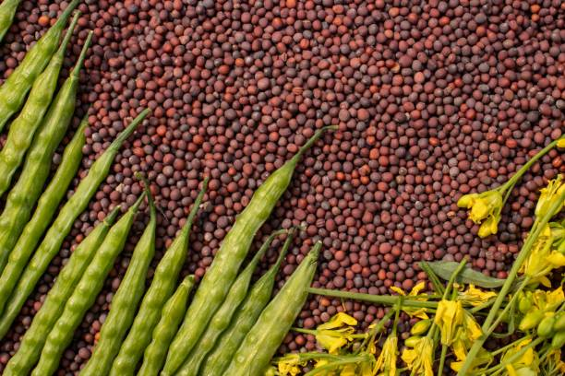
Project Overview:
The agricultural sector in India plays a crucial role in the economy, livelihoods, and food security of millions of people. However, the sector faces various challenges, including disparities in agricultural practices, dependence on external factors like weather conditions, and the need for sustainable farming practices. To address these challenges and improve decision-making in the agriculture sector, this internship project aims to conduct a comprehensive analysis of Indian agriculture using Power BI.

Slide 3
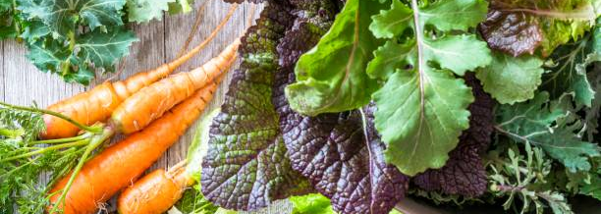
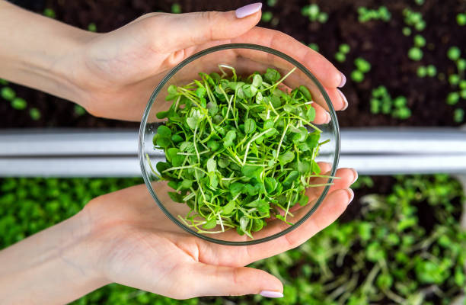
Dataset Introduction:
The dataset provided for this project encompasses a wide range of agricultural variables, including crop areas, production quantities, and yields across different districts and years. It contains detailed information on various crops cultivated in India, such as rice, wheat, sorghum, millets, pulses, oilseeds, sugarcane, fruits, and vegetables. Each record in the dataset represents the agricultural statistics for a specific district and year, allowing for district-wise and year-wise analysis.

Slide 4

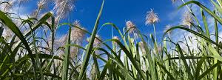
Problem Statement: The overarching objective of this project is to analyze Indian agriculture comprehensively, focusing on district-wise and year-wise data. By leveraging Power BI, the project aims to create interactive visualizations that reveal trends, patterns, and disparities in agricultural practices. The specific objectives include:
Data Exploration: Understand the distribution of agricultural variables across districts and years.
Crop-specific Analysis: Analyze trends in major crops like rice, wheat, and pulses, focusing on changes in area, production, and yield.
Regional Disparities: Identify variations in agricultural practices and outcomes across different districts and states.
Seasonal Patterns: Explore seasonal patterns in crop cultivation, considering kharif and rabi seasons.
Impact of External Factors: Investigate the influence of external factors such as weather conditions on crop performance.
Fruits and Vegetables Analysis: Analyze cultivation trends of fruits, vegetables, and their contribution to agricultural practices.
Sustainable Farming Insights: Derive insights to promote sustainable farming practices and optimize resource allocation.

Slide 5

DASHBOARD

Slide 6
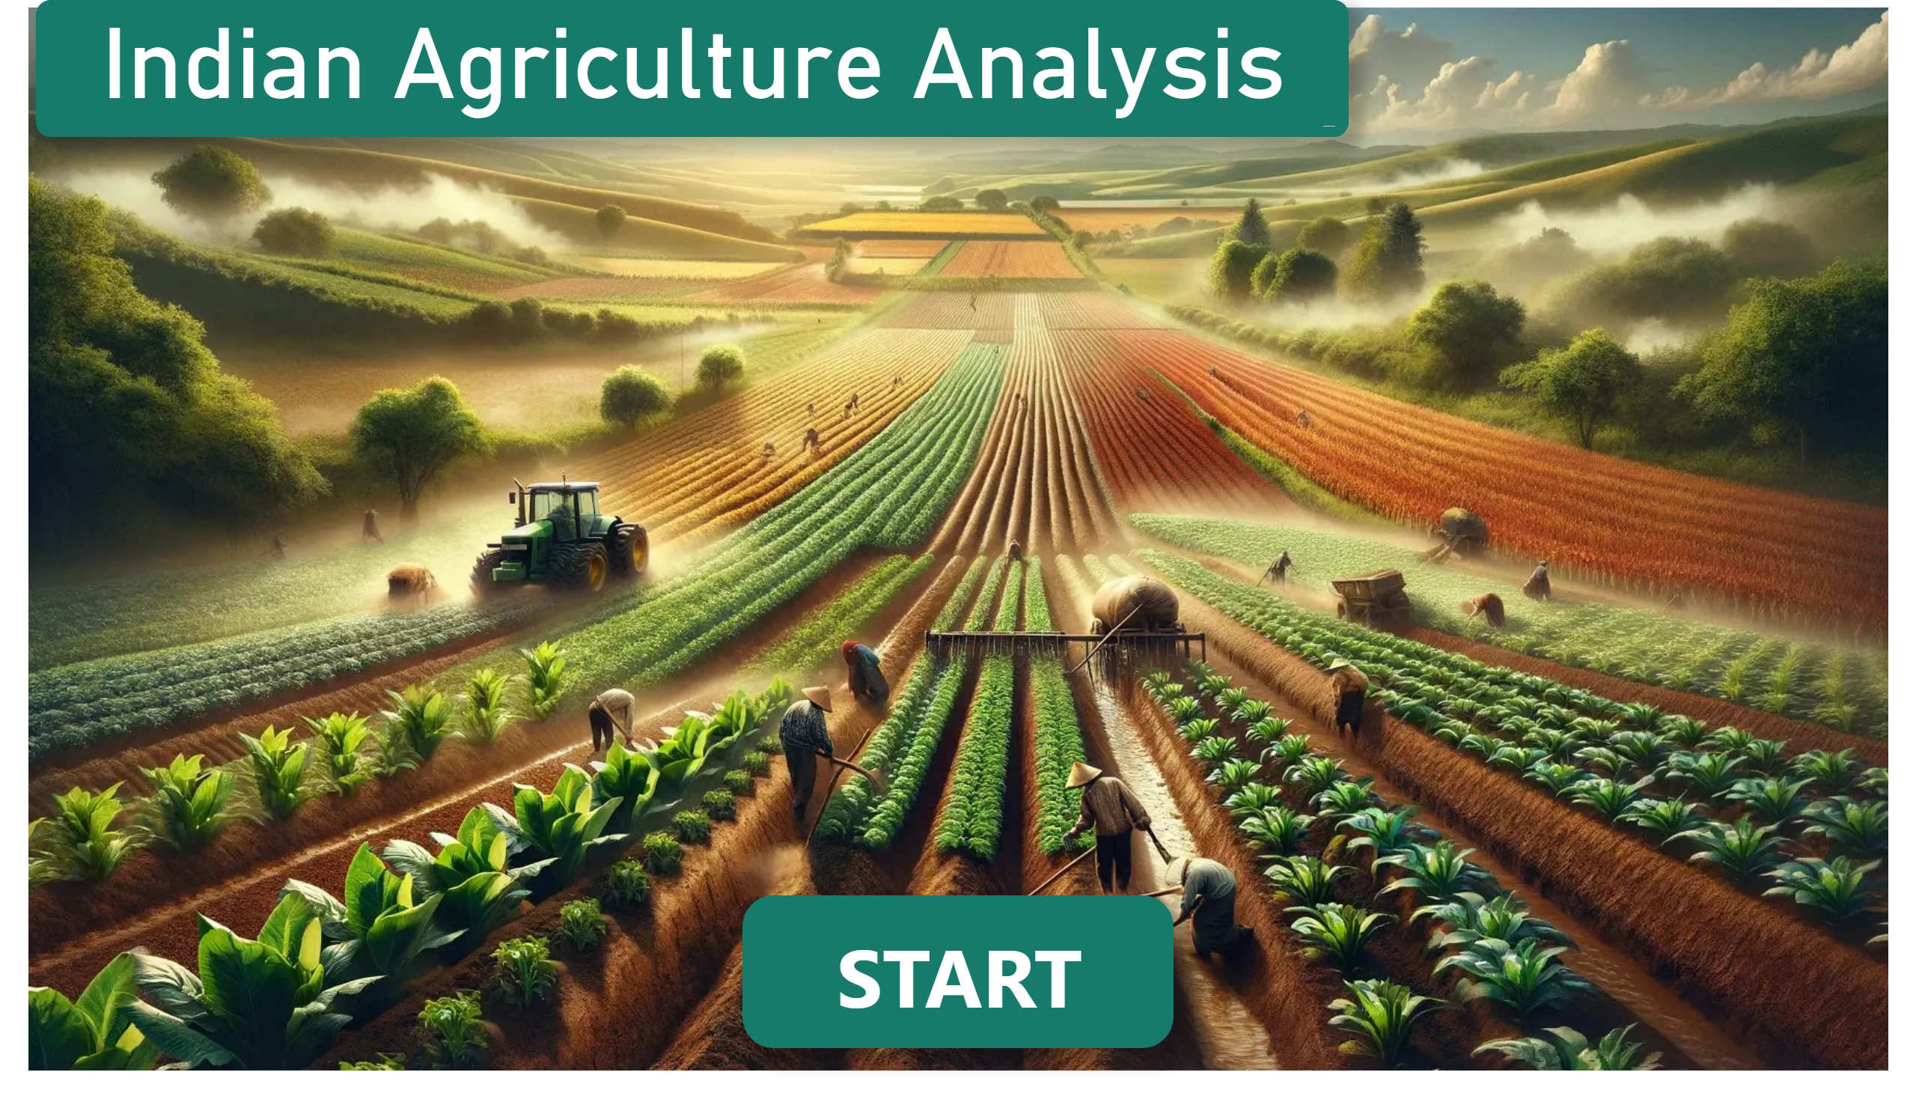
Home
Notes:
image
No alt text provided
Indian Agriculture Analysis
No alt text provided
actionButton
No alt text provided

Slide 7
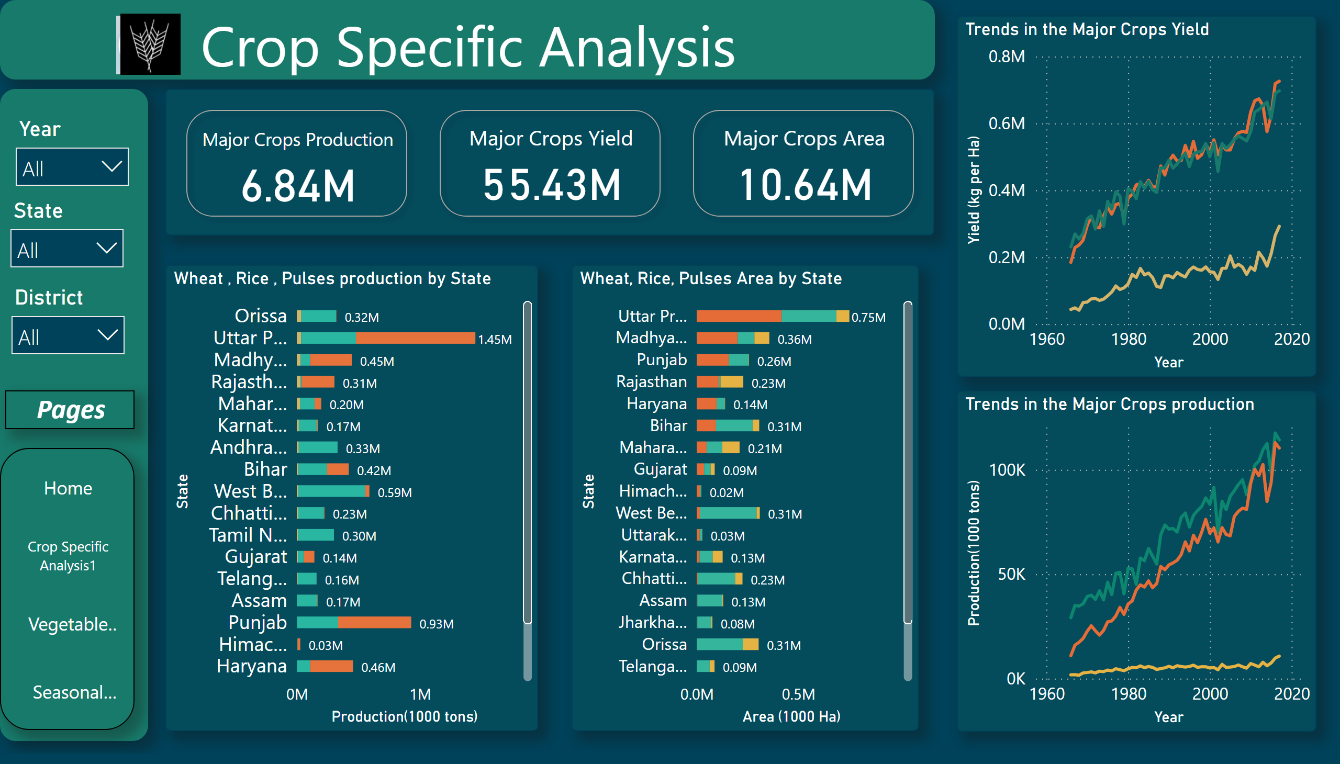
Crop Specific Analysis1
Notes:
Trends in the Major Crops production
No alt text provided
shape
No alt text provided
textbox
No alt text provided
Ship mode
No alt text provided
Ship mode
No alt text provided
Ship mode
No alt text provided
Trends in the Major Crops Yield
No alt text provided
Wheat, Rice, Pulses Area by State
No alt text provided
Wheat , Rice , Pulses production by State
No alt text provided
cardVisual
No alt text provided
pageNavigator
No alt text provided
Pages
No alt text provided
image
No alt text provided
image
No alt text provided

Slide 8
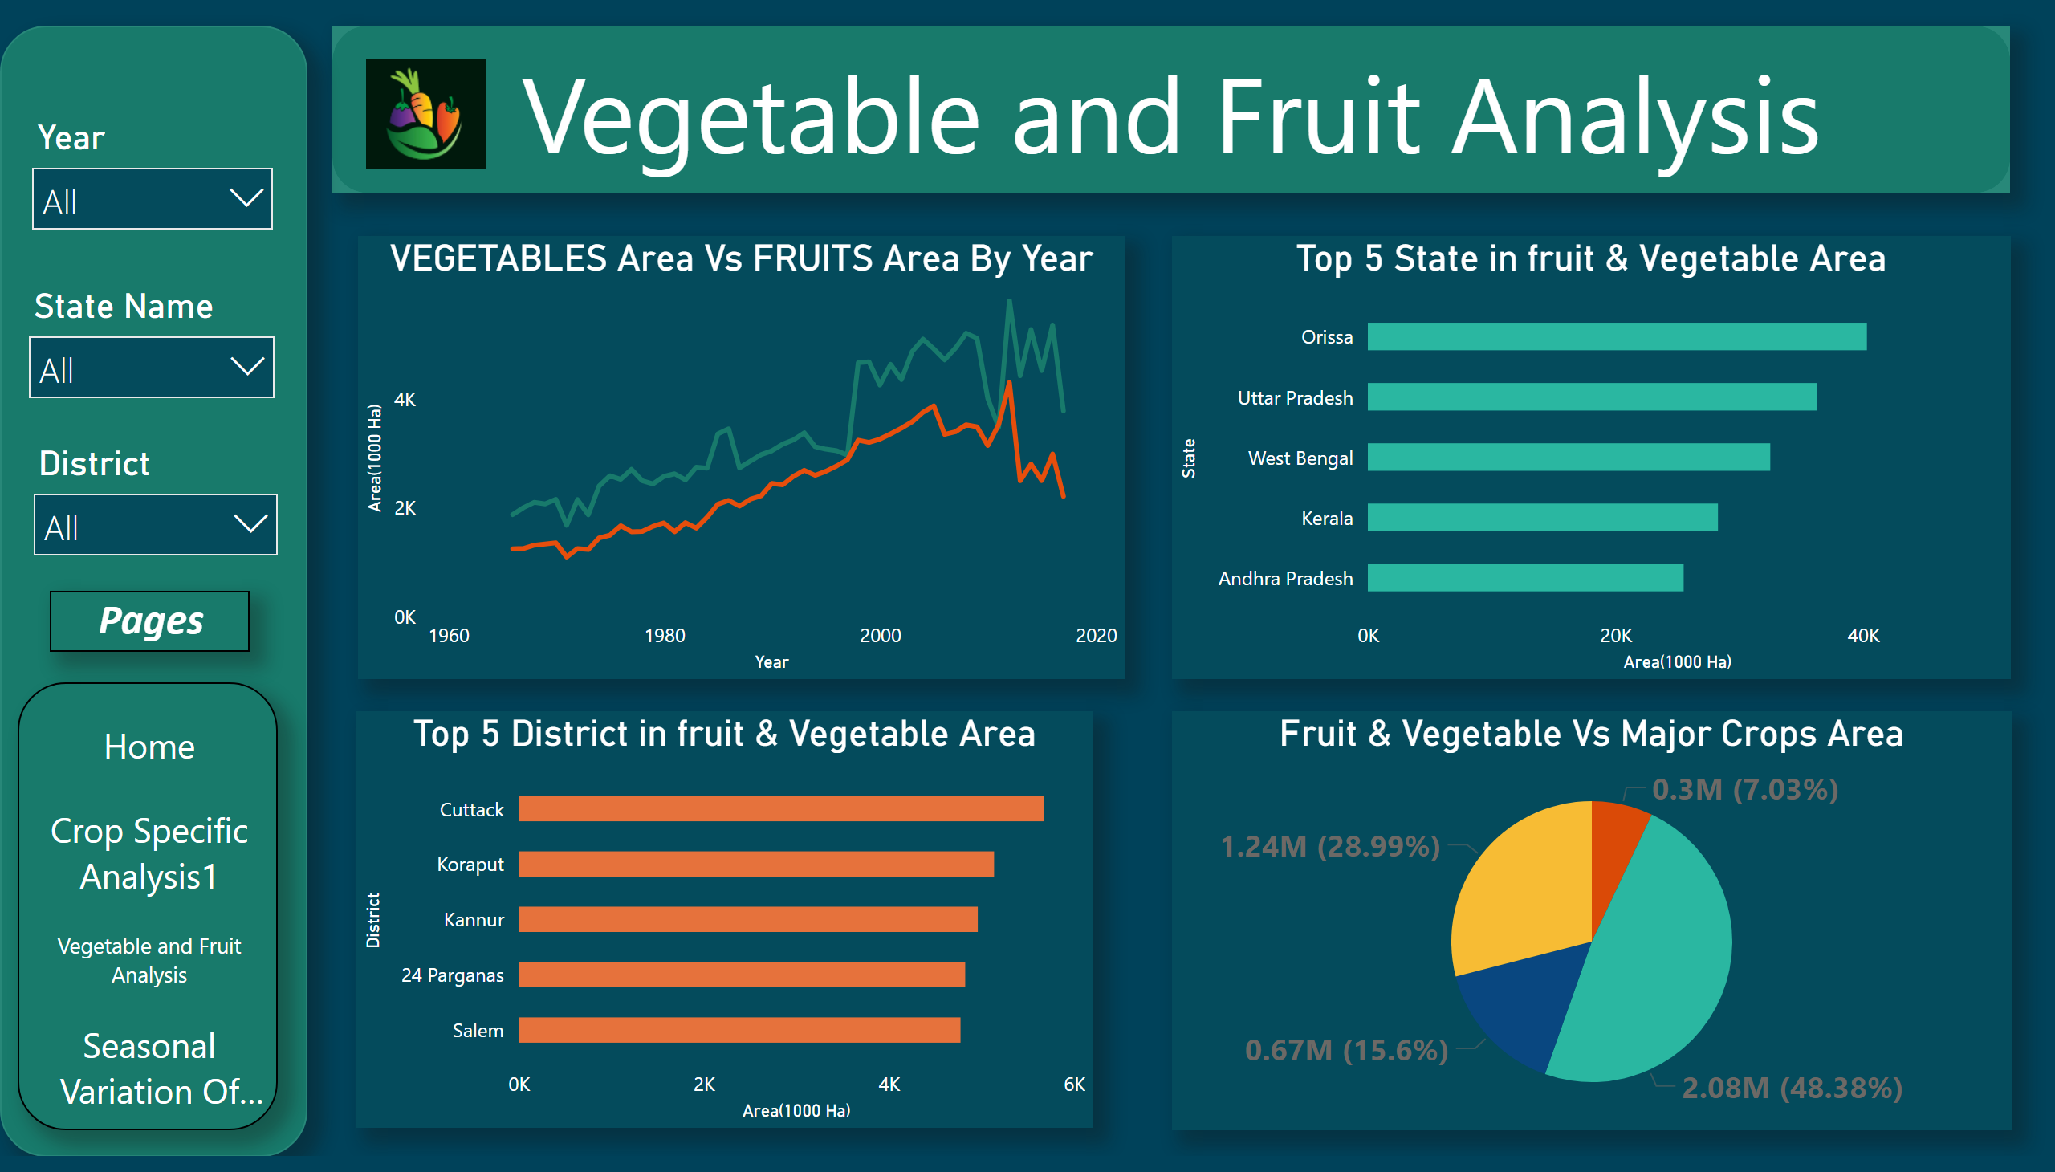
Vegetable and Fruit Analysis
Notes:
VEGETABLES Area Vs FRUITS Area By Year
No alt text provided
shape
No alt text provided
textbox
No alt text provided
Ship mode
No alt text provided
Ship mode
No alt text provided
Ship mode
No alt text provided
pageNavigator
No alt text provided
Pages
No alt text provided
Top 5 State in fruit & Vegetable Area
No alt text provided
Top 5 District in fruit & Vegetable Area
No alt text provided
Fruit & Vegetable Vs Major Crops Area
No alt text provided
image
No alt text provided

Slide 9
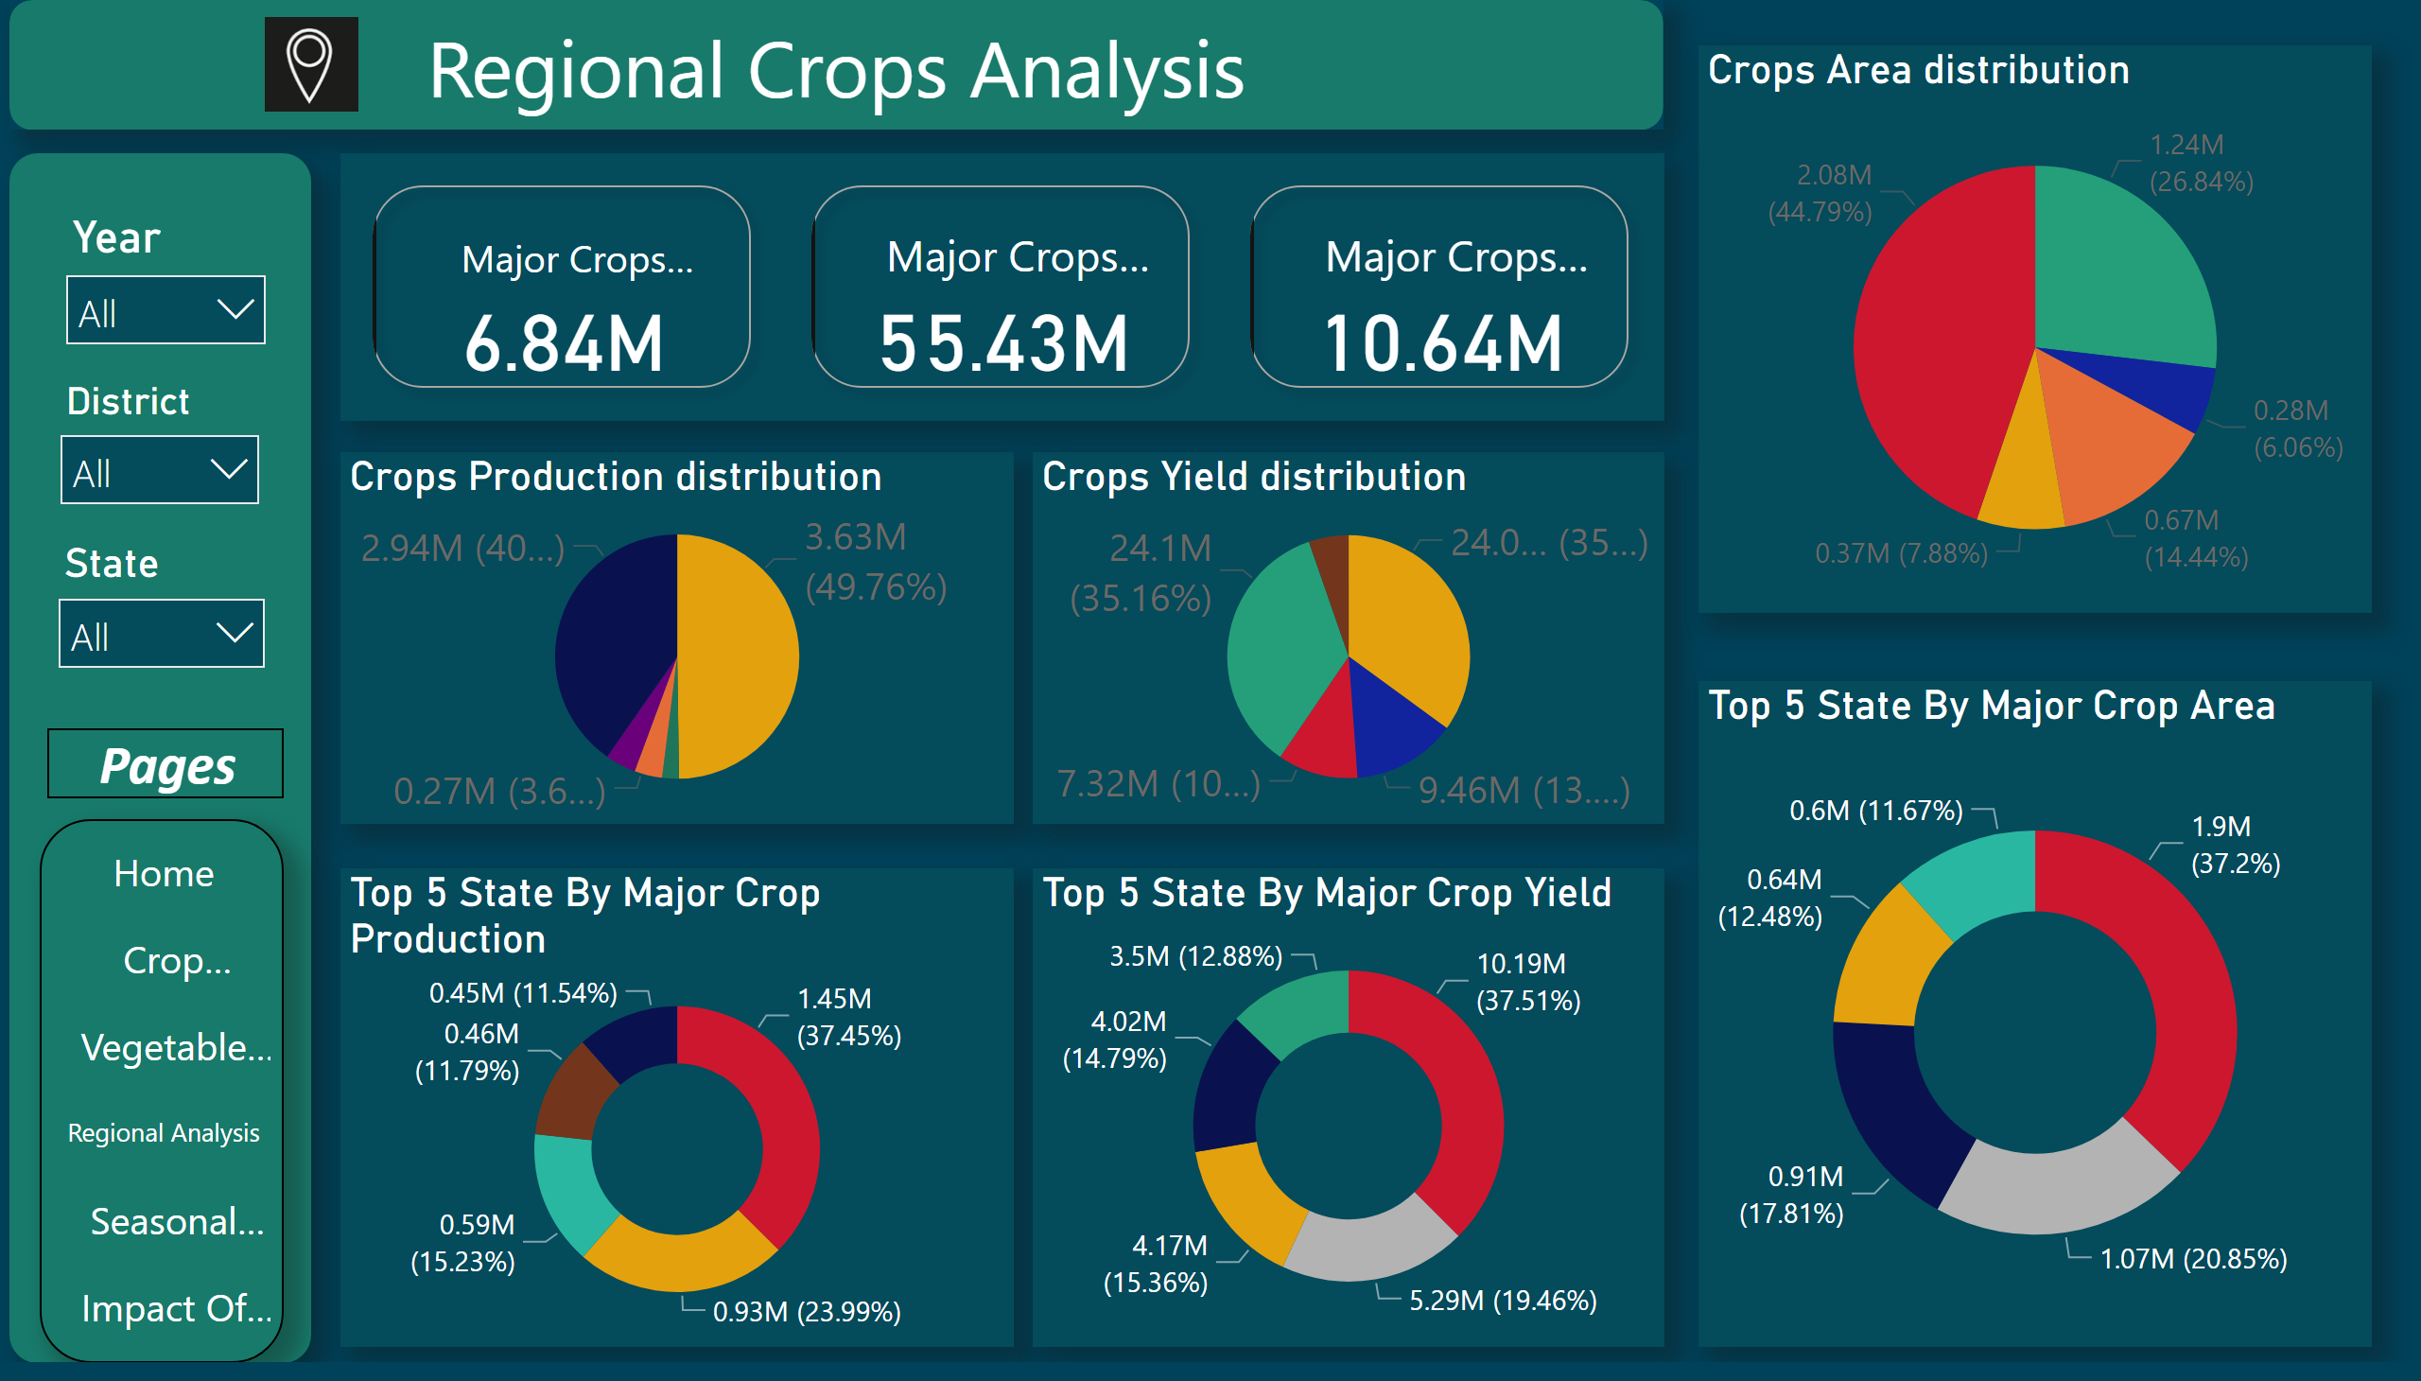
Regional Analysis
Notes:
Reigonal Analysis
No alt text provided
textbox
No alt text provided
pageNavigator
No alt text provided
Pages
No alt text provided
Crops Production distribution
No alt text provided
Top 5 State By Major Crop Area
No alt text provided
Top 5 State By Major Crop Production
No alt text provided
Top 5 State By Major Crop Yield
No alt text provided
slicer
No alt text provided
slicer
No alt text provided
Ship mode
No alt text provided
Crops Yield distribution
No alt text provided
Crops Area distribution
No alt text provided
cardVisual
No alt text provided
image
No alt text provided

Slide 10
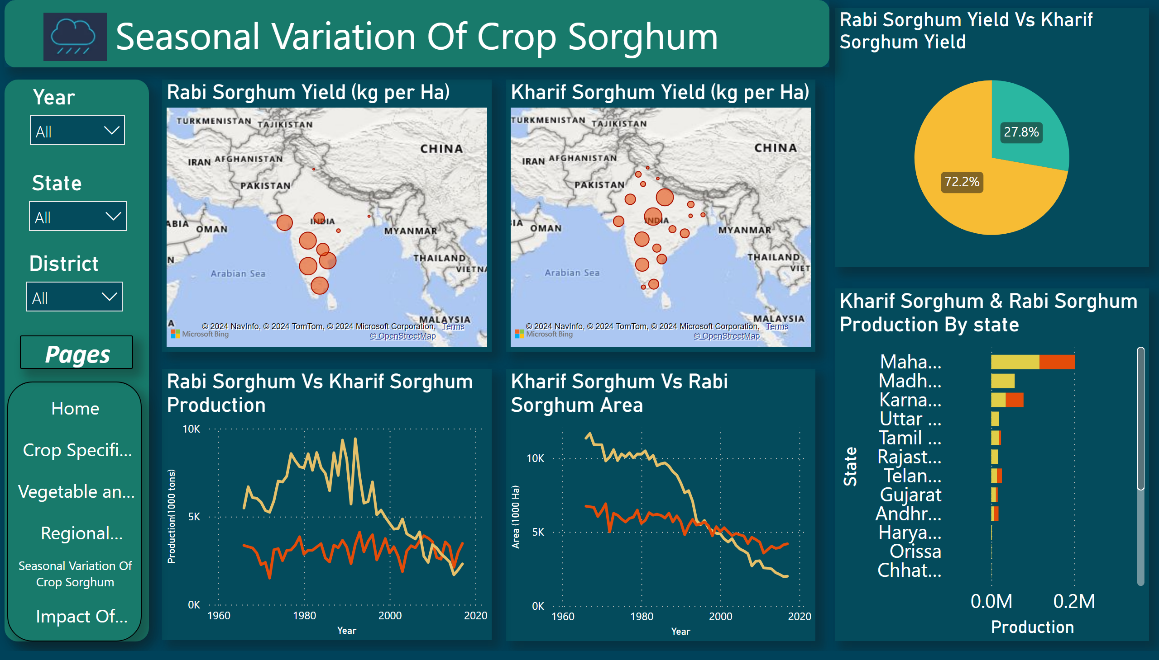
Seasonal Variation Of Crop Sorghum
Notes:
Kharif Sorghum Vs Rabi Sorghum Area
No alt text provided
Kharif Sorghum Yield (kg per Ha)
No alt text provided
Rabi Sorghum Yield (kg per Ha)
No alt text provided
Rabi Sorghum Yield Vs Kharif Sorghum Yield
No alt text provided
Rabi Sorghum Vs Kharif Sorghum Production
No alt text provided
shape
No alt text provided
textbox
No alt text provided
Ship mode
No alt text provided
Ship mode
No alt text provided
Ship mode
No alt text provided
pageNavigator
No alt text provided
Kharif Sorghum & Rabi Sorghum Production By state
No alt text provided
Pages
No alt text provided
image
No alt text provided
image
No alt text provided

Slide 11
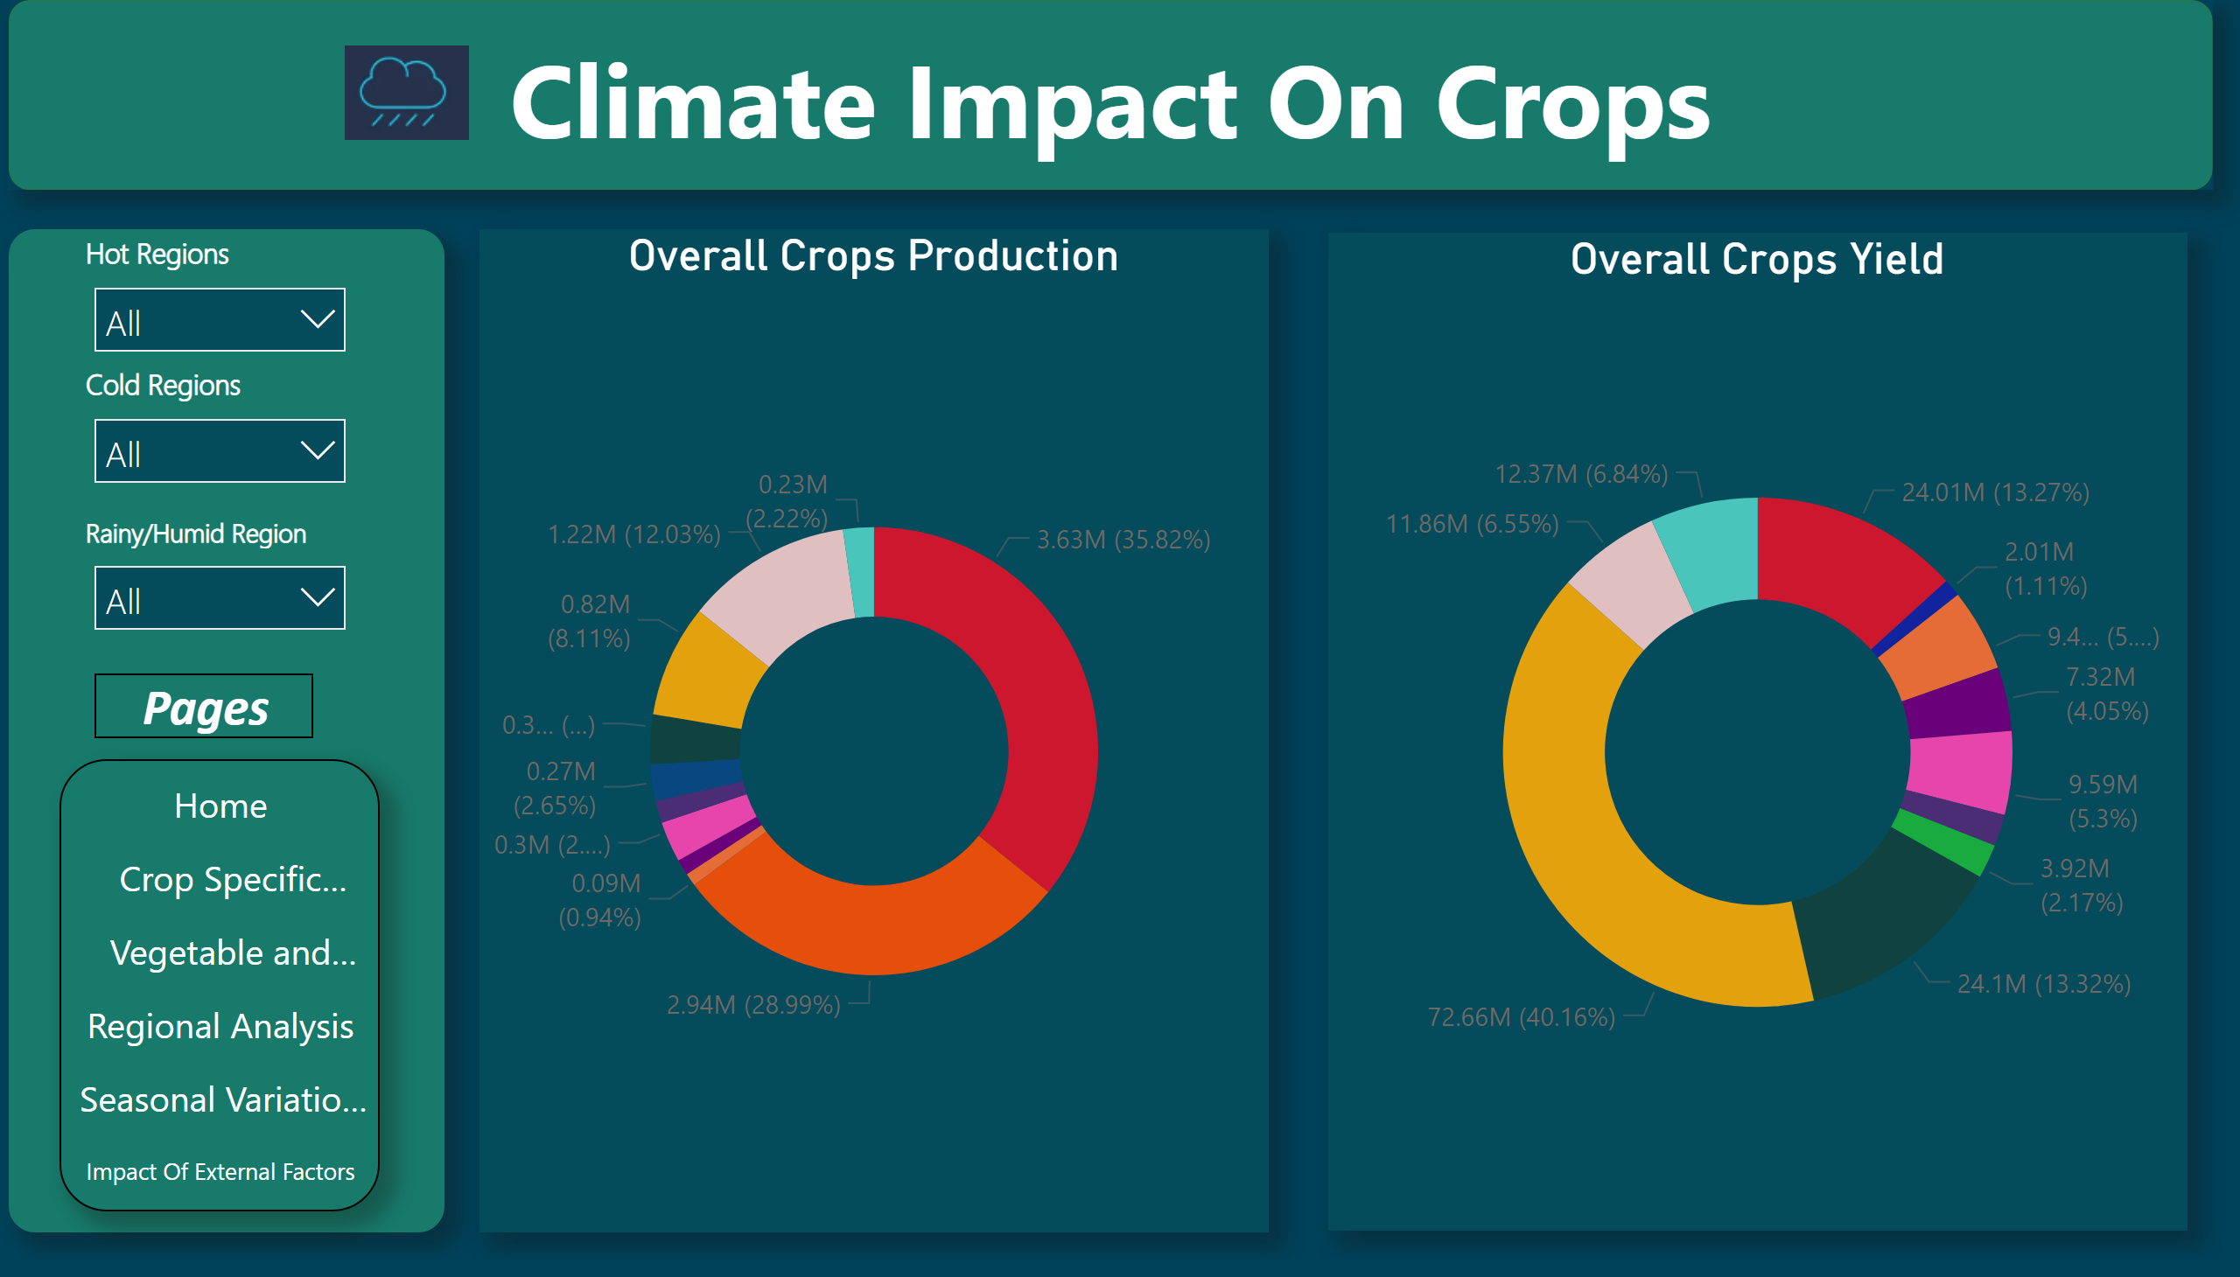
Impact Of External Factors
Notes:
shape
No alt text provided
textbox
No alt text provided
pageNavigator
No alt text provided
Pages
No alt text provided
image
No alt text provided
Overall Crops Production
No alt text provided
Cold Regions
No alt text provided
Rainy/Humid Region
No alt text provided
Hot Regions
No alt text provided
Overall Crops Yield
No alt text provided

Slide 12
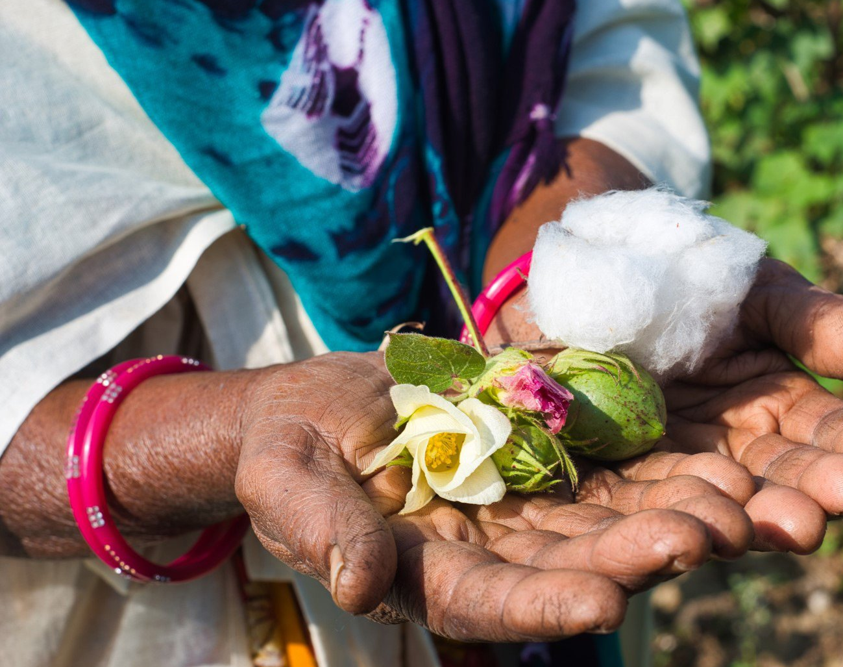
INSIGHTS:
Crop Specific Analysis:
Uttar Pradesh, Madhya Pradesh, and Bihar dominate rice, wheat, and pulses production.
Himachal Pradesh, Uttarakhand, and Kerala have smaller cultivation areas.
Higher crop yields observed in Uttar Pradesh, Rajasthan, and Madhya Pradesh, while Chhattisgarh exhibits lower yields.
Fruit & Vegetable Analysis:
Fruits and vegetables cultivated on only 7% of total area.
Top fruit and vegetable cultivating states: Odisha, Uttar Pradesh, West Bengal, Kerala, Andhra Pradesh.
Regional Analysis:
Top 5 states in major crop production: UP, MP, Punjab, West Bengal, Haryana.
Top 5 states in major crop yield: UP, MP, Rajasthan, Punjab, West Bengal.
Rice and wheat account for 40% and 49% of total major crop production, respectively, with consistent 35% yield each.
Seasonal Variation of Sorghum Crops:
Rabi crop production remains steady, while Kharif production and cultivation area decline since the early 1990s.
Kharif crops demonstrate nearly three times the yield of Rabi crops.
Impact of Climate:
Hot regions (Rajasthan, Gujarat, Maharashtra, MP, UP, Punjab) cultivate wheat, oilseeds, and barley.
Cold regions (Himachal Pradesh, Uttarakhand) focus on wheat and rice cultivation.
Rainy/humid regions prioritize rice cultivation, with sugarcane boasting the highest yield.

Slide 13

"Strategies for Sustainable Farming and Resource Optimization in India"
Localized Techniques: Tailor farming methods to local conditions, promote indigenous practices, and reduce reliance on chemicals.
Water Management: Implement drip irrigation, rainwater harvesting, and soil moisture conservation to optimize water use.
Crop Diversity: Encourage diverse crops, rotations, and intercropping to improve soil health and resilience.
Technology Use: Utilize remote sensing, IoT, and data analytics for informed decision-making and precision farming.
Agroecology Principles: Integrate ecological processes, enhance biodiversity, and minimize external inputs for sustainable agriculture.
Education Initiatives: Provide training, workshops, and extension services to empower farmers with knowledge and skills.
Policy Support: Implement subsidies, incentives, and regulations to promote sustainable practices and support agricultural resilience.
Market Access: Facilitate access to markets for sustainably produced goods, aligning with consumer preferences and certification standards.

Slide 14
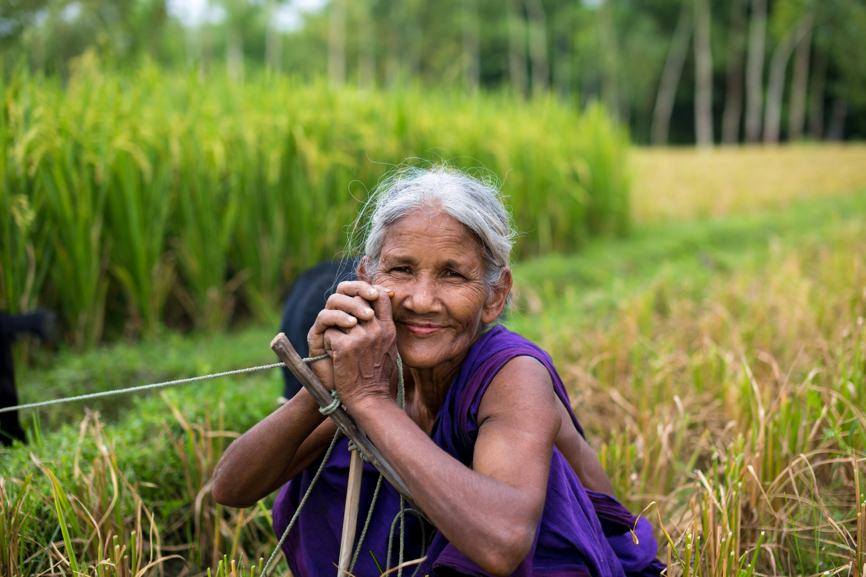
THANK YOU

